Slide 1
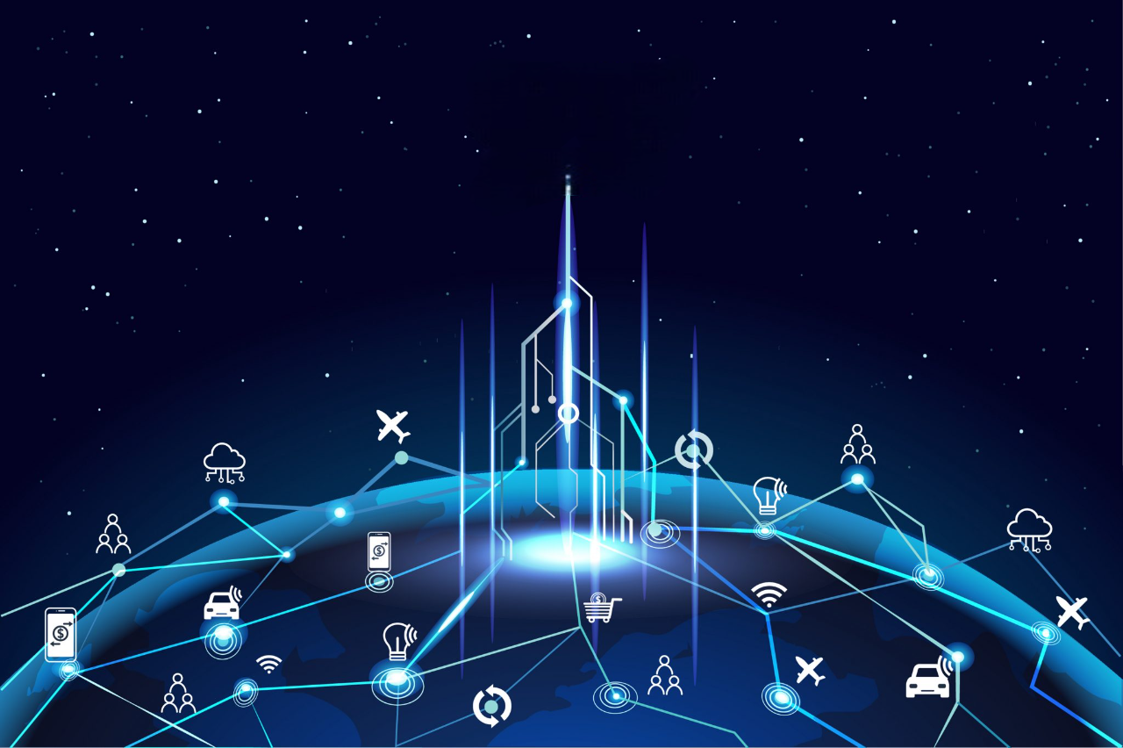
Basics of IoT

Slide 2
Presentation Overview
What is IoT?
Defining the Internet of Things (IoT)
Tracing the Evolution of IoT
Industry Evolution
How does IoT work?
What is an example of an Internet of Things device?
IoT benefits to organizations
Why is IoT so important
Challenges of Internet of Things (IoT)
Advantages
Disadvantages
Conclusion
References

Slide 3
What is IoT?
IoT stands for Internet of Things.
It refers to the interconnectedness of physical devices, such as appliances and vehicles, that are embedded with software, sensors, and connectivity which enables these objects to connect and exchange data.
This technology allows for the collection and sharing of data from a vast network of devices, creating opportunities for more efficient and automated systems.

Slide 4
Defining the Internet of Things (IoT)
Internet of Things (IoT) is the networking of physical objects that contain electronics embedded within their architecture in order to communicate and sense interactions amongst each other or with respect to the external environment.
In the upcoming years, IoT-based technology will offer advanced levels of services and practically change the way people lead their daily lives.
Advancements in medicine, power, gene therapies, agriculture, smart cities, and smart homes are just a few of the categorical examples where IoT is strongly established.

Slide 5
Tracing the Evolution of IoT
Years | Evolution
1982 | Vending machine
1990 | Toaster
1999 | IoT Coined by Kevin Ashton
2000 | LG Smart Fridge
2004 | Smart Watch
2007 | Smart iPhone
2009 | Car Testing
2011 | Smart TV
2013 | Google Lens
2014 | Echo
2015 | Tesla Autopilot

Slide 6
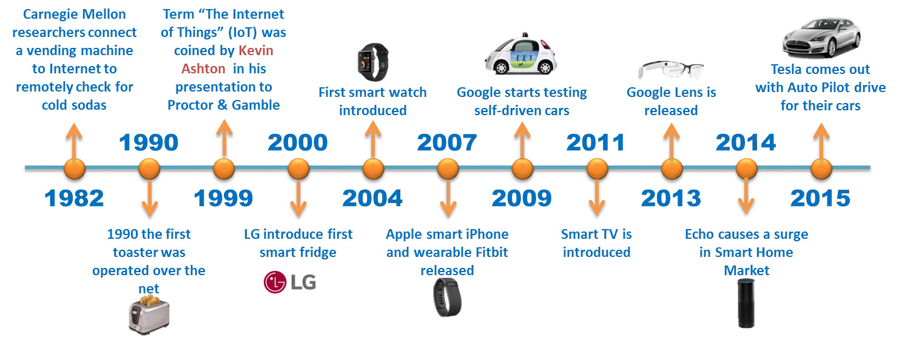
Figure : Evolution of IoT

Slide 7
Industry Evolution
The Internet of Things (IoT) has transformed industries by enabling seamless connectivity between physical devices, digital systems, and real-time data analytics. Its evolution has been shaped by technological advances, market demands, and the continuous pursuit of automation and intelligence. From its conceptual beginnings to its current role as a cornerstone of Industry 4.0, the journey of IoT reflects significant milestones in both innovation and adoption.
Early Foundations(1980s – 2000s)
Expansion and Adoption (2010 - 2020)
Modern Trends (2020 - Present)

Slide 8
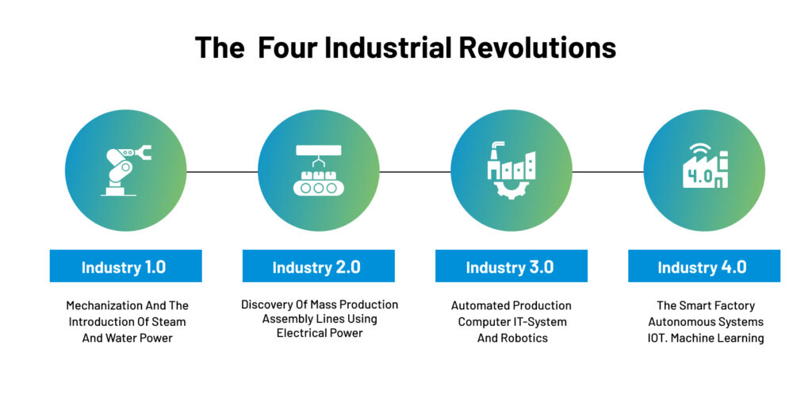
Figure : The Four Industrial Revolutions

Slide 9
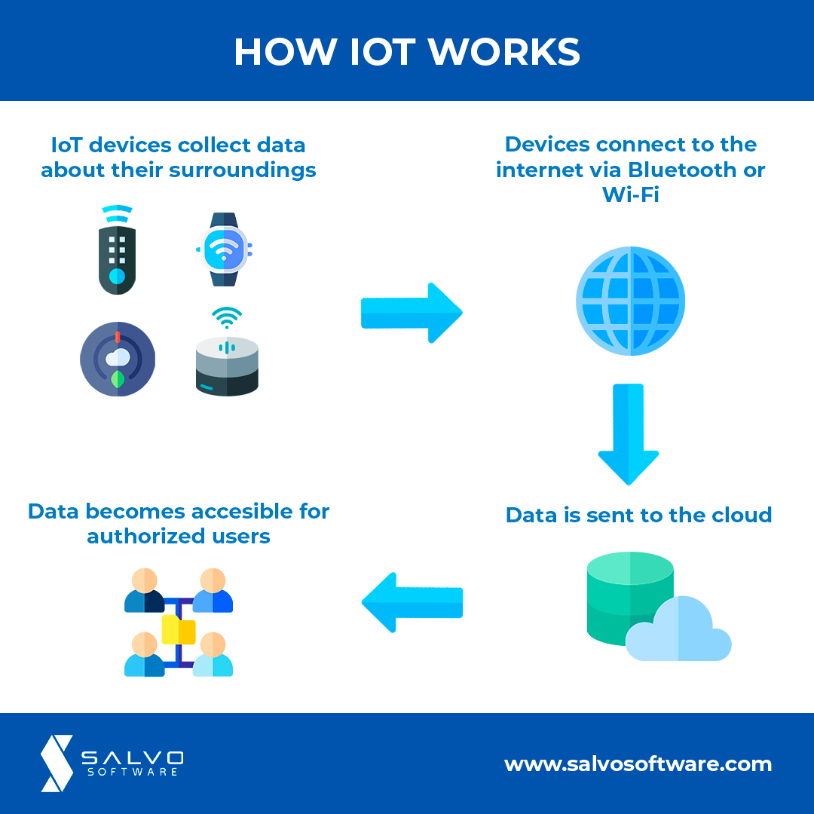
How does IoT work?
A typical IoT system works through the real-time collection and exchange of data. An IoT system has three components:
Smart devices
IoT application
A graphical user interface
Figure : How IoT works

Slide 10
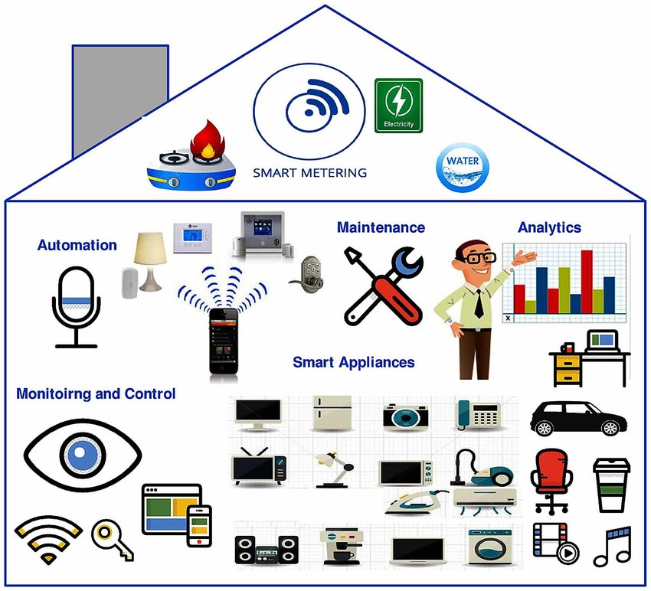
What is an example of IoT devices?
Let’s look at some examples of IoT systems in use today:
Connected cars
Connected homes
Smart cities
Smart buildings
Figure : IoT Smart Home

Slide 11
IoT benefit to organizations
The Internet of Things (IoT) has emerged as a game-changing technology for organizations across industries. It connects physical devices to the internet, allowing them to collect and exchange data in real time. This data-driven connectivity helps organizations optimize operations, reduce costs, improve safety, and deliver better services. As IoT continues to evolve, its impact on organizational growth, innovation, and competitiveness becomes increasingly evident.
Accelerate Innovation
Turn Data into Insights and Actions with AI and ML
Increase Security
Scale Differentiated Solutions

Slide 12
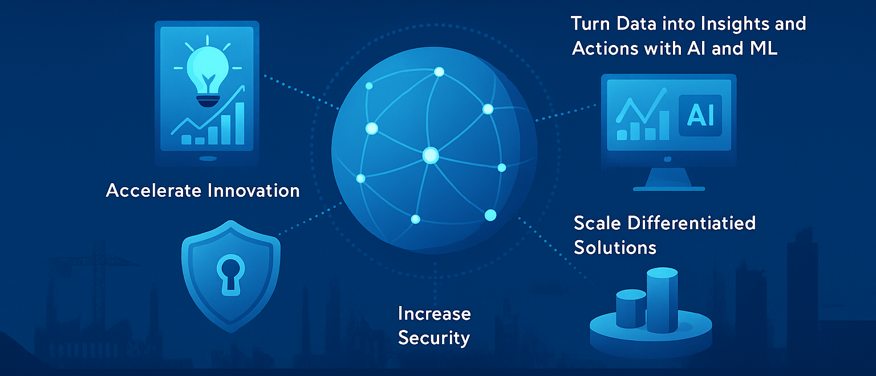
Figure : IoT benefits to Organization

Slide 13
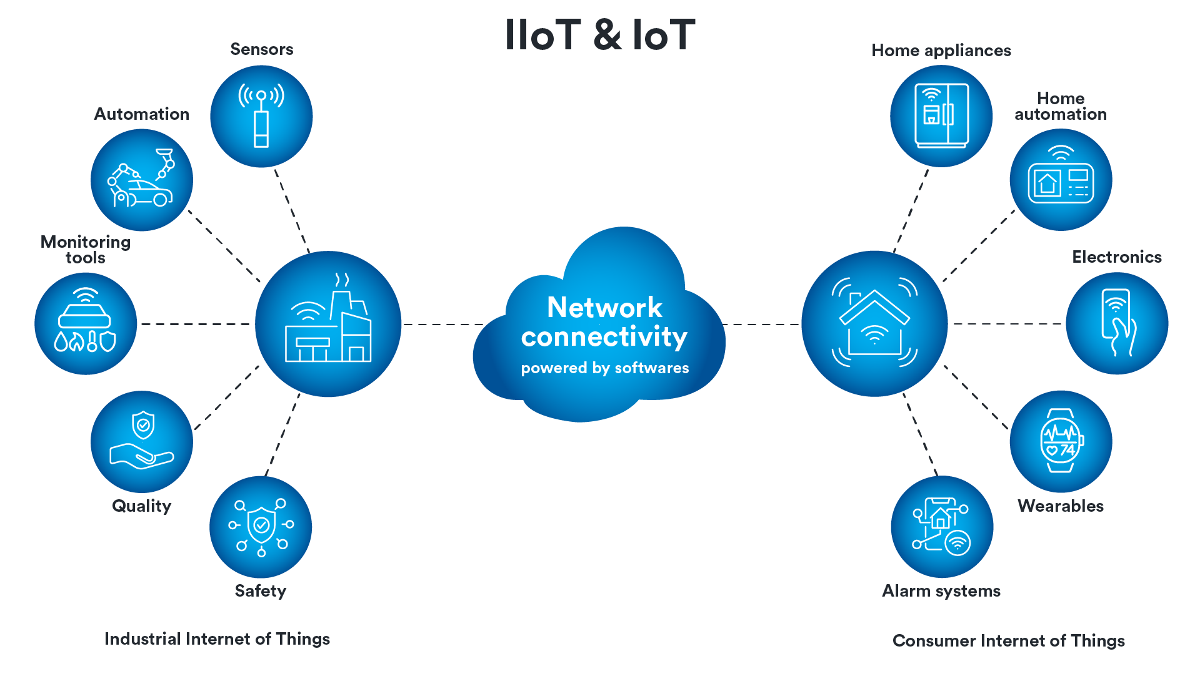
Why is IoT so important?
The Internet of Things (IoT) has become a vital enabler of digital transformation in modern organizations. It refers to a system of interconnected devices that gather and exchange data in real time.

Slide 14
From smart sensors to connected machines, IoT is helping organizations unlock new levels of efficiency, cost-effectiveness, data intelligence, and customer satisfaction. Here’s an in-depth look at the key benefits IoT offers to organizations:
Improved Efficiency and Productivity
Data-Driven Decision-Making
Cost Savings
Enhanced Customer Experience

Slide 15
Challenges of IoT
While the Internet of Things (IoT) has opened up exciting opportunities for automation, data-driven decision-making, and operational efficiency, its widespread adoption also brings with it several challenges and concerns.
These challenges span technical, organizational, legal, and ethical domains and must be addressed to ensure safe, scalable, and sustainable IoT deployments.

Slide 16
1. The Hardware-Software Issue:
IoT is not a device-related technology, but, it is not a simple technology. So, testing of the IoT application cover both Hardware & Software.
2. Data Security Threats:
Some of the IoT requires a frequent transfer of data from individual device to different over a networked and their data security comes into pictures. And that’s why IoT testers require to do vulnerability tests and penetration testing to identify and then choose security defects.

Slide 17
3. The Network Configuration of the Devices:
IoT applications and devices extensively depend on the network over which they are interconnected for their continuous process.
4. Scalability of Operations:
Scalability is a characteristic of a system, model and IoT applications need to control the sudden peak in traffic to get added into the system operations.

Slide 18
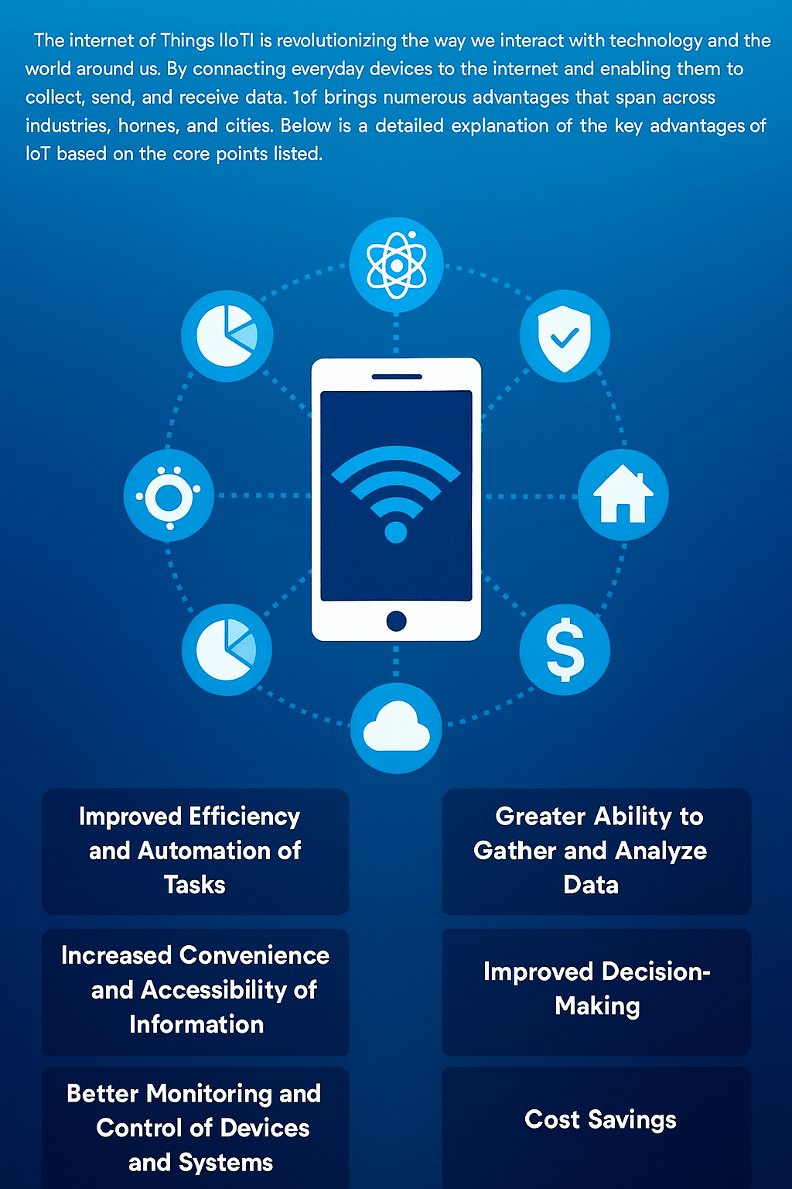
Advantages
The Internet of Things (IoT) is revolutionizing the way we interact with technology and the world around us.
By connecting everyday devices to the internet and enabling them to collect, send, and receive data, IoT brings numerous advantages that span across industries, homes, and cities.

Slide 19
Below is a detailed explanation of the key advantages of IoT based on the core points listed.
Improved Efficiency and Automation of Tasks
Increased Convenience and Accessibility of Information
Better Monitoring and Control of Devices and Systems
Greater Ability to Gather and Analyze Data
Improved Decision-Making
Cost Savings

Slide 20
Disadvantages
The Internet of Things (IoT) has revolutionized the way we interact with technology, offering numerous benefits such as increased efficiency, real-time monitoring, and data-driven decision-making.
However, despite its many advantages, IoT also presents several significant disadvantages and challenges that need to be carefully addressed.

Slide 21
Below is an elaboration of the key drawbacks of IoT technology:
Security Concerns and Potential for Hacking or Data Breaches
Privacy Issues
Dependence on Technology and Risk of System Failures
Limited Standardization and Interoperability
Complexity and Maintenance Requirements
High Initial Investment Costs

Slide 22
Conclusion
IoT enables the interconnection of devices, allowing data collection, analysis, and improved decision-making.
IoT holds immense potential to transform industries, enhance user experiences, and drive efficiency.
The future of IoT is bright, and it will shape the way we live, work, and interact with our surroundings.

Slide 23
Thank You

